Slide 1
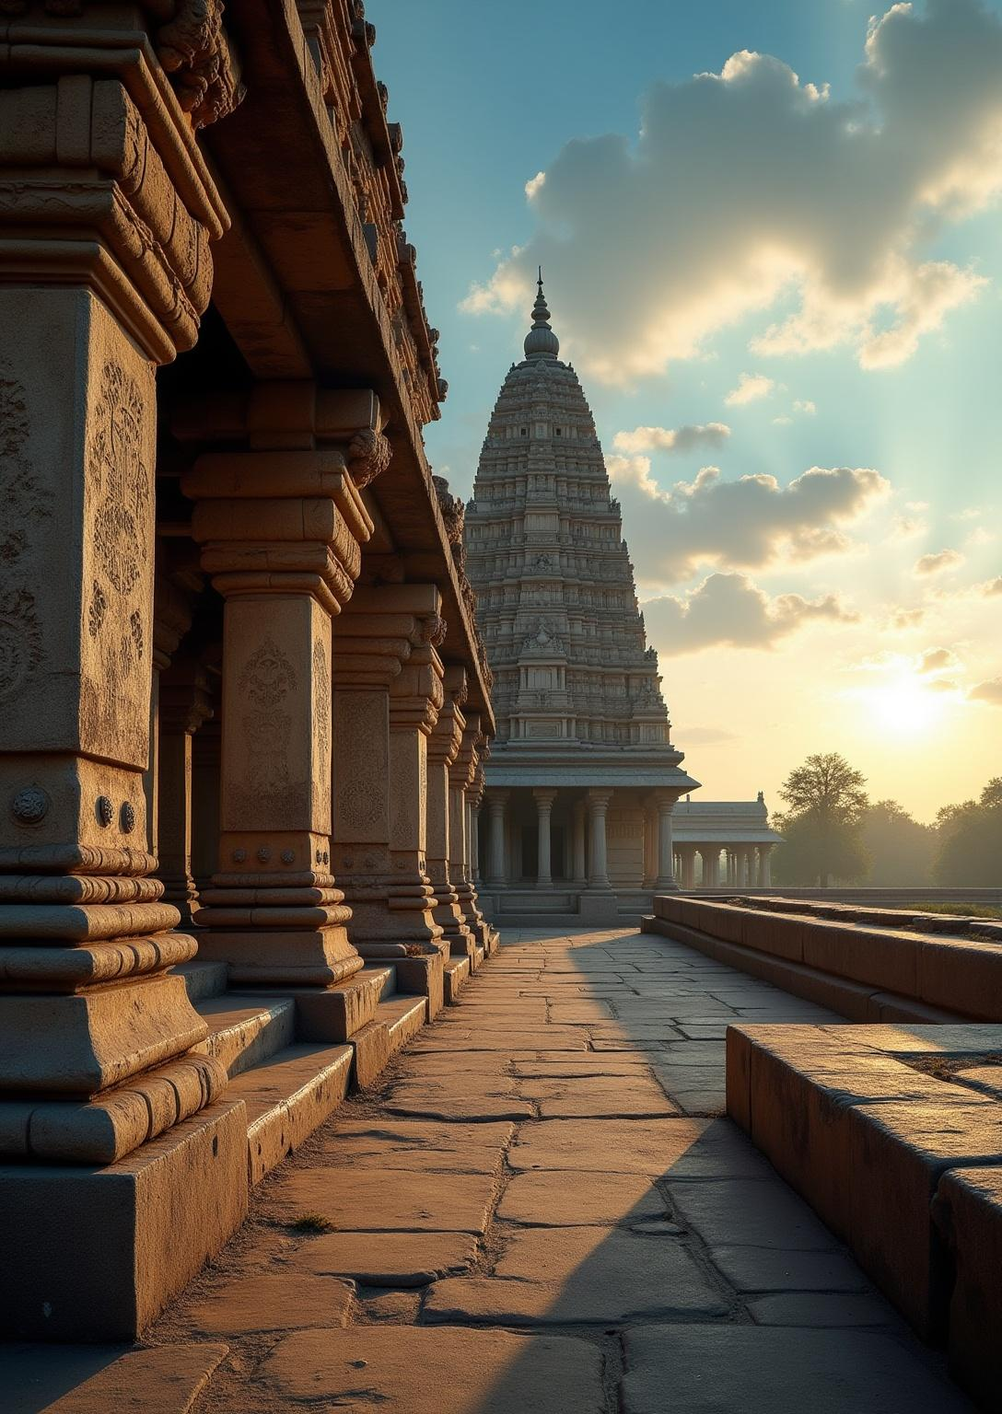
Sacred Ensembles of the
Hoysalas
Tourism project
By Tarun Hansdah

Slide 2
No. | Content | Page No.
1 | Introduction | 3
2 | Historical Background | 5
3 | UNESCO World Heritage Recognition | 6
4 | Cultural and religious importance | 7
5 | Location | 9
6 | Route | 11
7 | Conclusion | 12

Slide 3
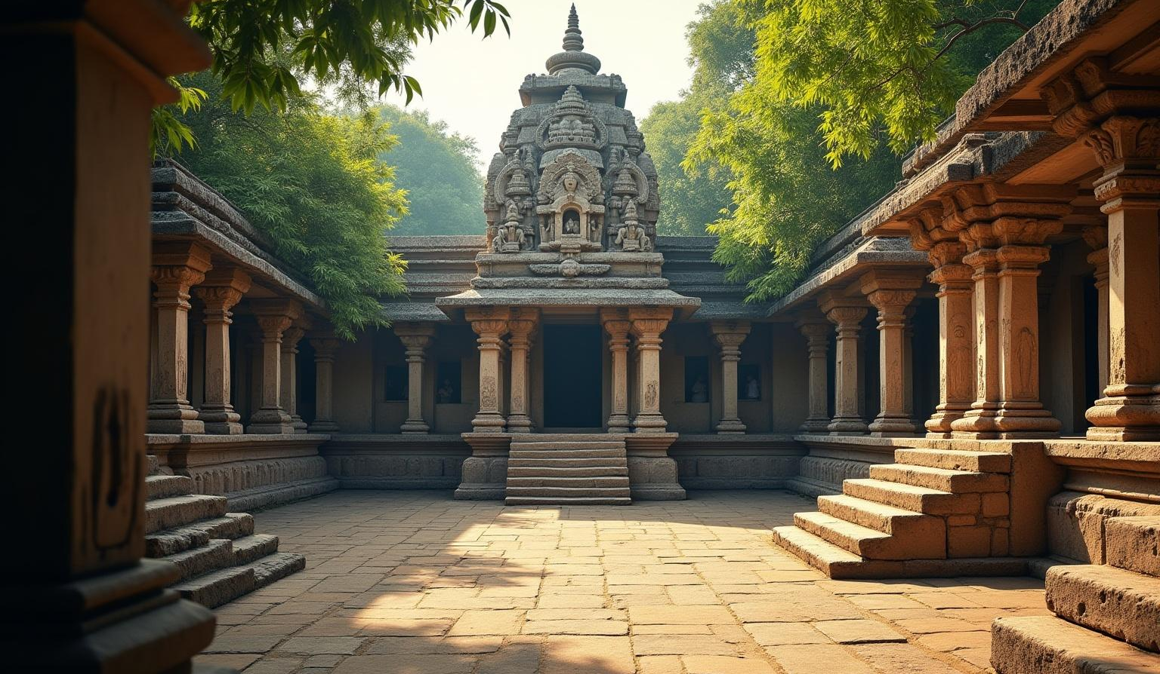
01. Introduction to Hoysala Sacred Ensembles

Slide 4
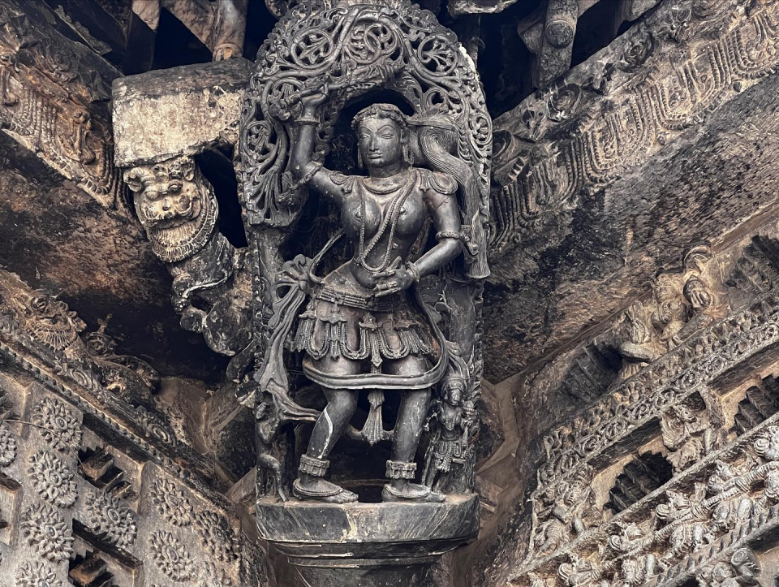
Nestled in Karnataka, the Sacred Ensembles of the Hoysalas represent a pinnacle of medieval South Indian temple architecture. Built during the 12th and 13th centuries by the Hoysala dynasty, these temples blend devotion and artistry, symbolizing a rich spiritual and cultural heritage recognized globally.

Slide 5
Historical background of the Hoysala dynasty
The Hoysala dynasty, ruling from the 11th to 14th centuries, was pivotal in advancing temple architecture in southern India. Under leaders such as King Vishnuvardhana, their reign marked a period of artistic and religious flourishing that left a lasting heritage reflected in their temples.

Slide 6
UNESCO World Heritage Recognition
In 2023, the Sacred Ensembles of the Hoysalas were designated as a UNESCO World Heritage Site, acknowledging their exceptional architectural and cultural significance. This recognition highlights their global value as masterpieces of medieval Indian art and devotion.

Slide 7
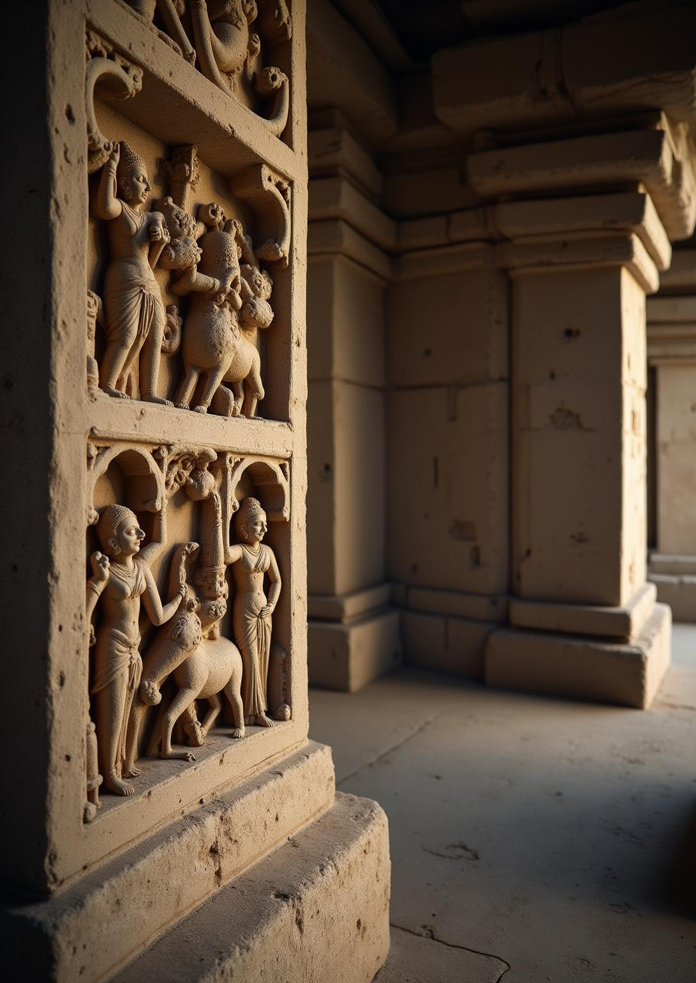
Cultural and religious importance
The Hoysala temples serve as vital centers of spiritual worship and cultural expression. They preserve important narratives from Indian epics such as the Ramayana and Mahabharata, reflecting deep religious devotion. These ensembles also functioned historically as hubs for artistic, social, and community activities, embodying the cultural ethos of the period.

Slide 8
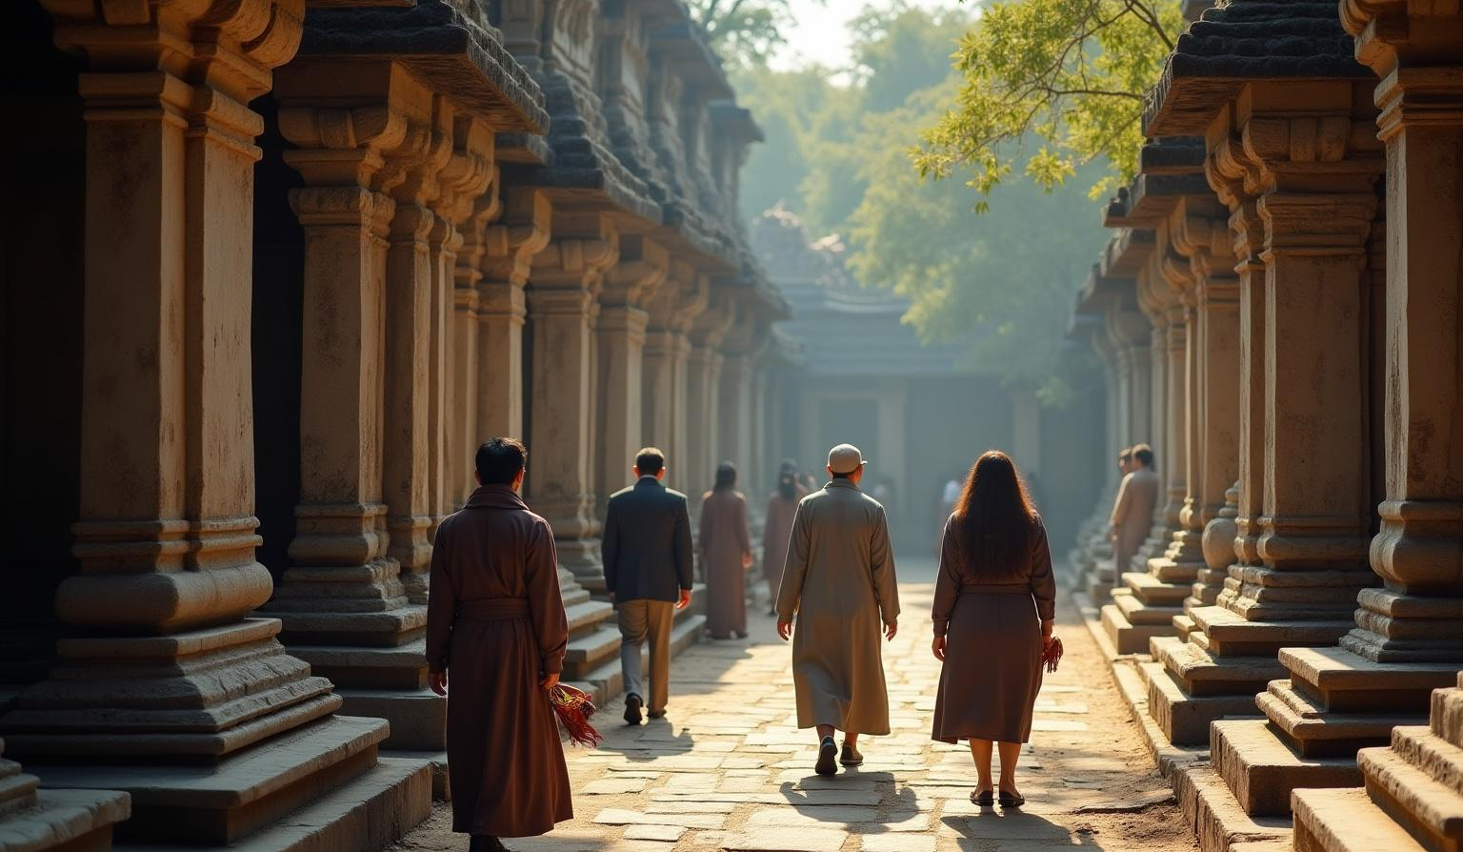
02
Visiting the Sacred Ensembles

Slide 9
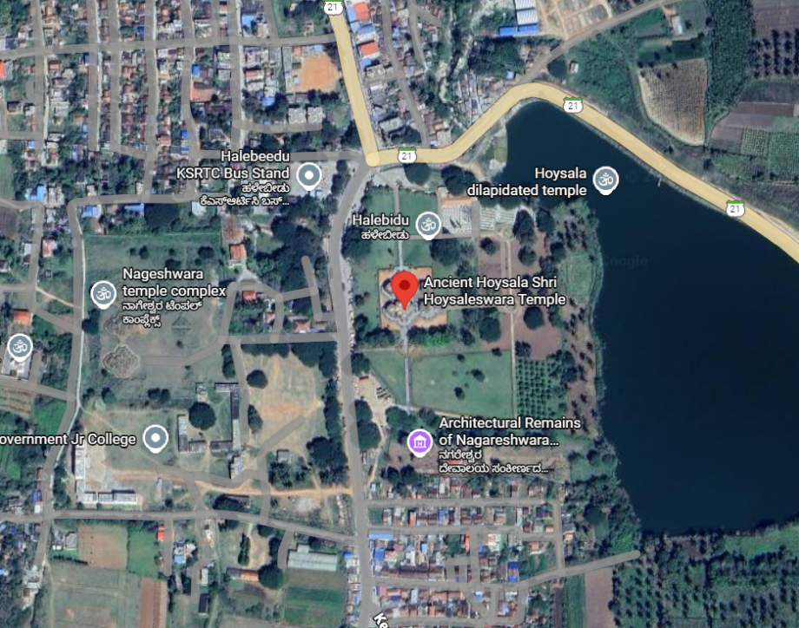
Location
Located about 20 kilometeres east from Belur. The Sacred Ensembles provide an intricate look in history

Slide 10
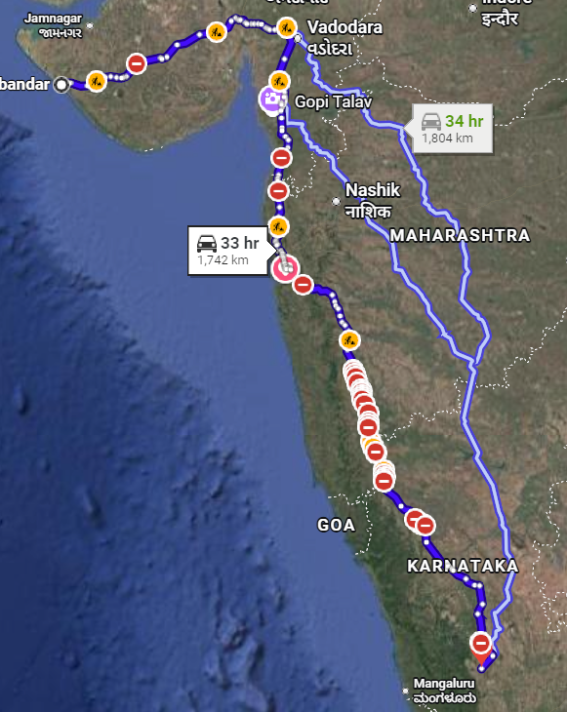
Route(via Road)

Slide 11
Route from Porbandar
By Road:
1700 – 1800km
Route: Porbandar → Rajkot → Ahmedabad → Vadodara → Nashik → Pune → Kolhapur → Hubballi → Hassan → Belur / Halebidu
25-28 hours
By Air:
Route: Porbandar →Bus/Train →Ahmedabad → Bengaluru → Bus/Taxi → Belur/Halebidu
1-2hour(Flight), 4-5(Road)

Slide 12
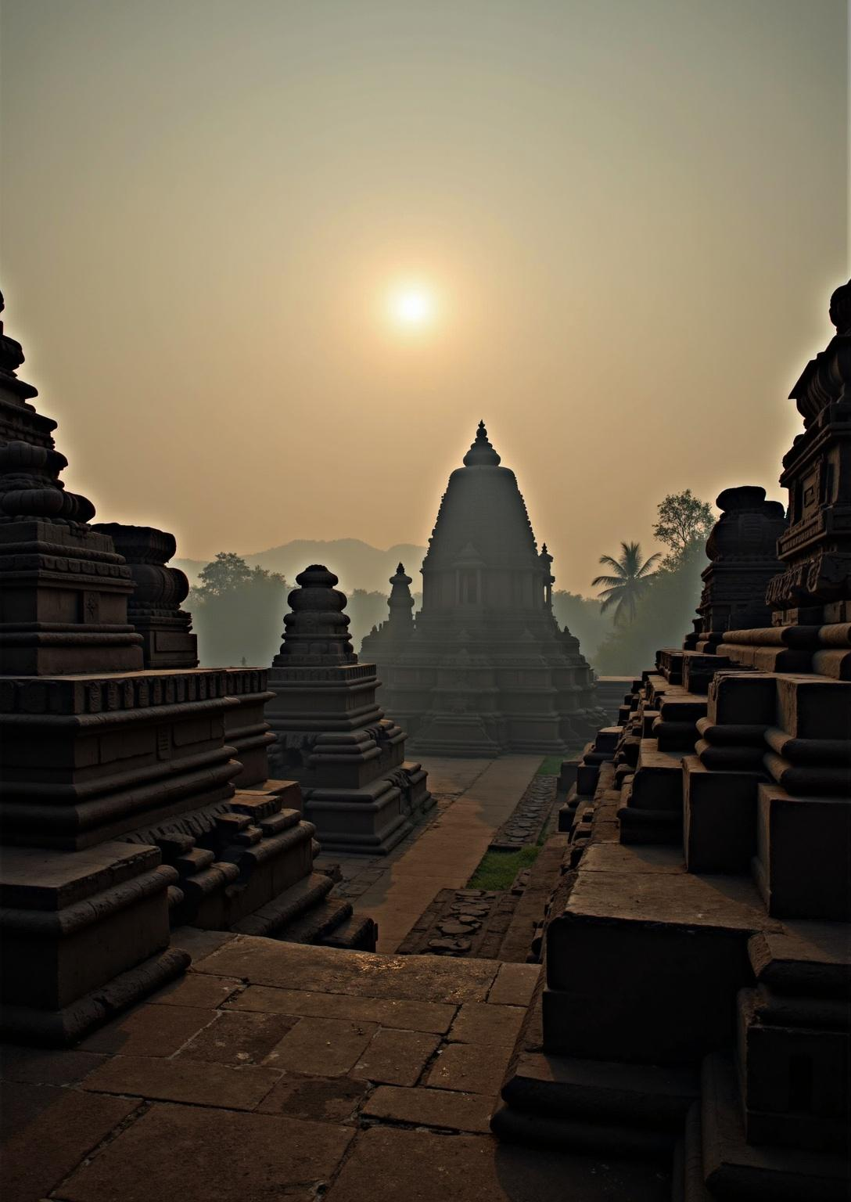
Conclusion
The Sacred Ensembles of the Hoysalas stand as timeless testaments to medieval Indian architectural innovation and religious artistry. Their intricate designs, spiritual significance, and historical legacy continue to inspire and attract scholars and visitors worldwide, underscoring Karnataka’s rich cultural heritage and the enduring value of these UNESCO-recognized monuments.

Slide 13
Thank You!
Presentation by
Tarun Hansdah
Roll no. 16, Class XII
Under the guidance of
Ms. Vandana Ozi ma’ am

